Slide 1
CLASS SIX
Review, More Arrays, & Arraylists

Slide 2
Review
class, main(), variables, methods, console i/o, conditionals
return methods, loops, arrays
Notes:
Arrays are the fourth basic element after variable & method assignments, conditionals, and loops that is found in every programming language. After this class, you can solve all sorts of problems just using these four pointers.

Slide 3
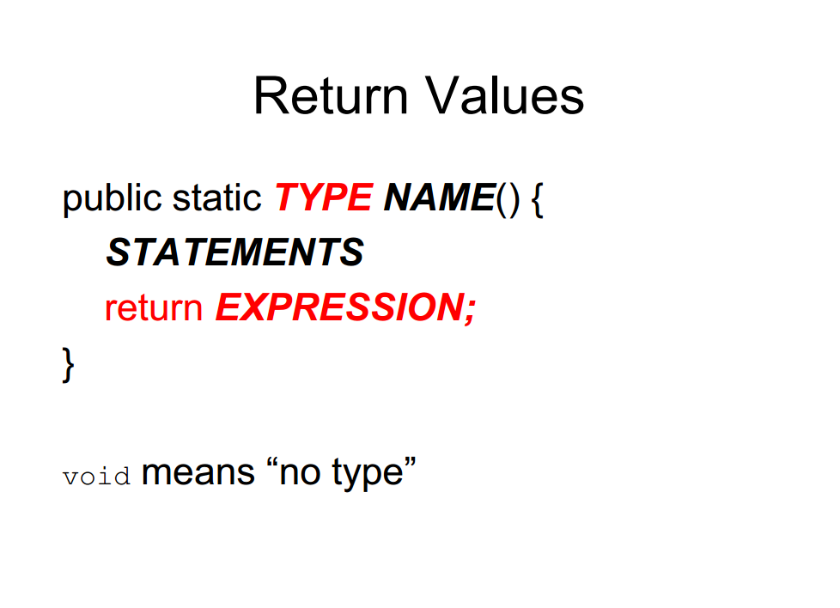
Notes:
Some of the methods we are using, like the Math methods, return values.
so far all our methods have been void; that is, methods that return no value. When you invoke a void method, it is typically on a line by itself, with no assignment:
countdown(3); nLines(3);
In this chapter we write methods that return things
The first thing you should notice is that the beginning of the method definition is different. Instead of public static void, which indicates a void method, we see public static double, which means that the return value from this method is a double. I still haven’t explained what public static means, but be patient.

Slide 4
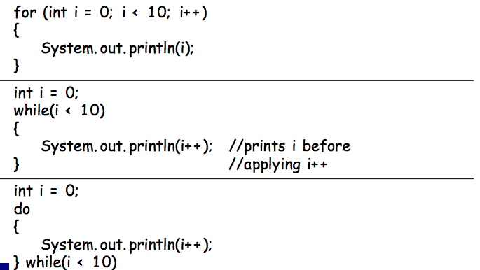
Loops:

Slide 5
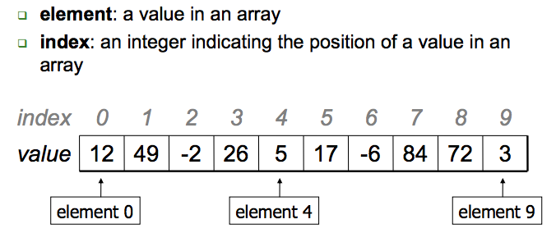
Arrays
An array is an indexed list of values.
You can make an array of any type int, double, String, etc.
All elements of an array must have the same type.
Notes:
An array is a set of values where each value is identified by an index. You can make an array of ints, doubles, or any other type, but all the values in an array have to have the same type.
Syntactically, array types look like other Java types except they are followed by []. For example, int[] is the type “array of integers” and double[] is the type “array of doubles.”
The primary purpose of an array is to facilitate storing and manipulating large quantities of data.
An array stores a sequence of values that are all of the same type.

Slide 6
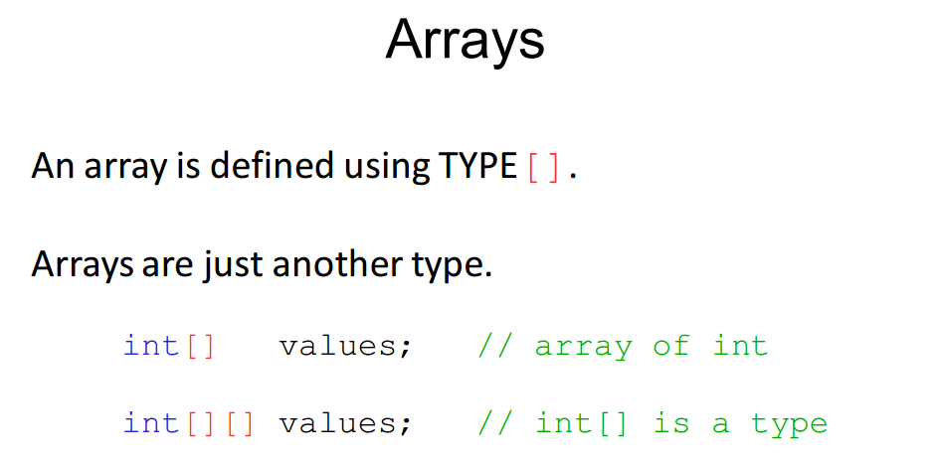

Slide 7
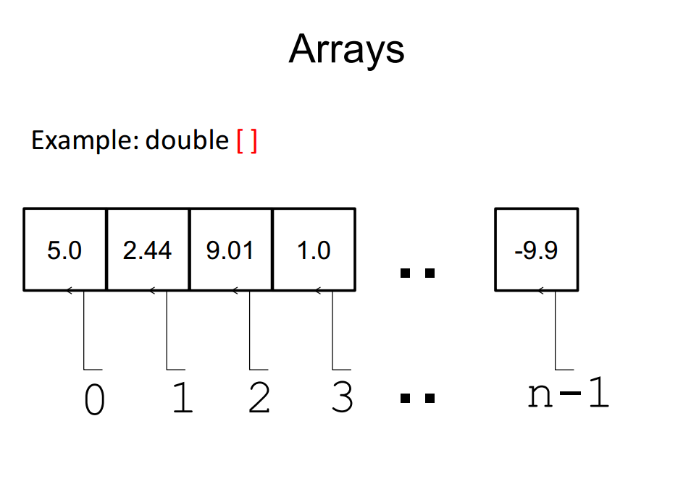

Slide 8
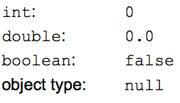
Array Initialization
double [] a = new double[5];
OR
double [] a = {1, 2, 3, 4, 5}
Default values:
The default initial value is:
zero for numbers
false for type boolean
null for String (and other non-primitive type)
Notes:
Use new to allocate memory for an array before accessing any of its elements

Slide 9
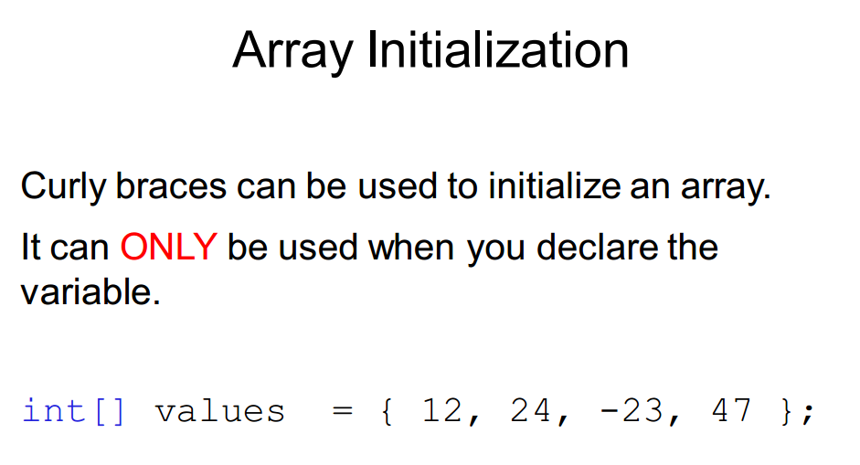

Slide 10
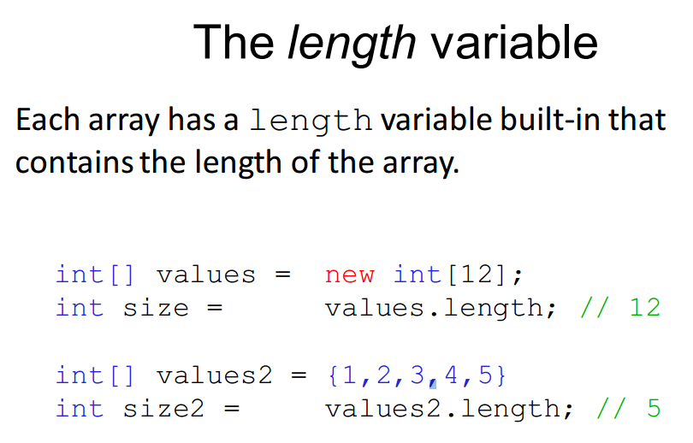
Notes:
ArrayIndexOutOfBounds

Slide 11
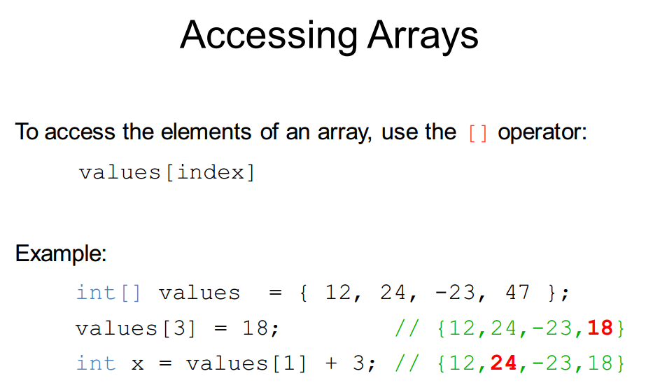

Slide 12
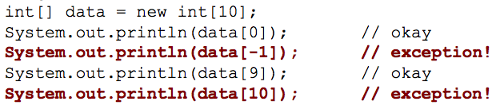
Don’t go out of bounds!
Read or writing any index outside the valid range will throw an ArrayIndexOutOfBoundsException

Slide 13
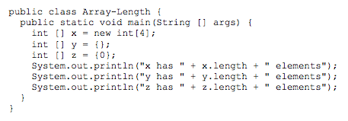
Understanding Code Exercise

Slide 14
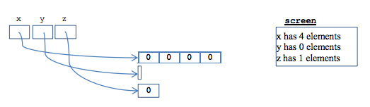
Understanding Code

Slide 15
Combining Loops & Arrays

Slide 16
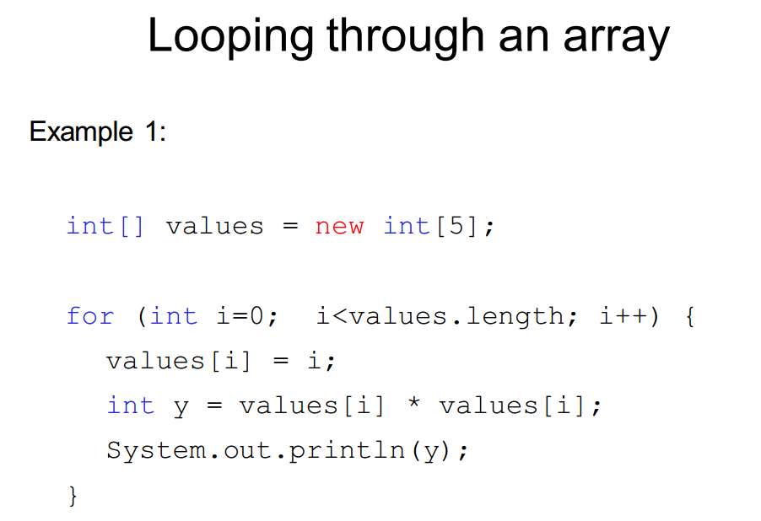

Slide 17
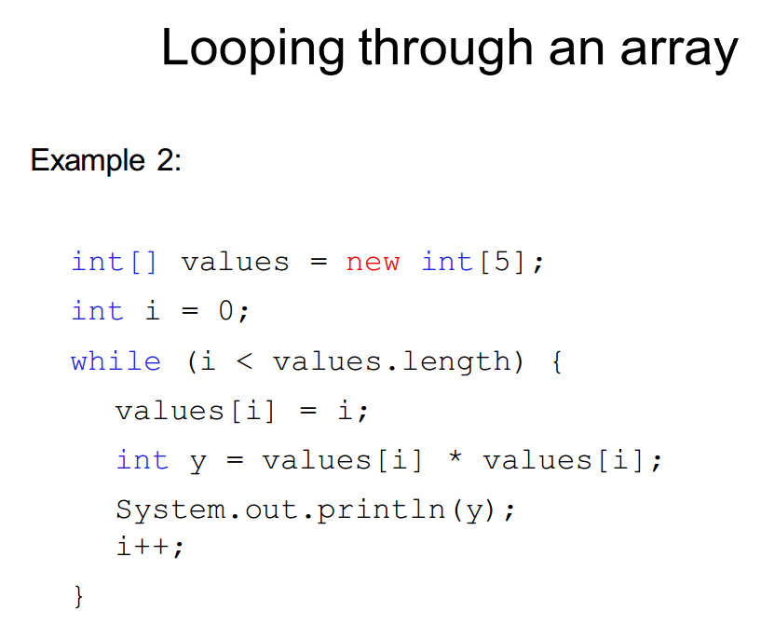

Slide 18
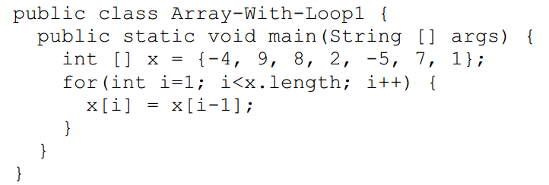
Understanding Code

Slide 19
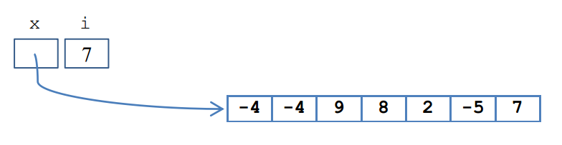
Understanding Code

Slide 20
Array Exercise
Print the values of an array, one per line

Slide 21
Array Exercise
Write a method makeRandom(int n) that returns an array of n random numbers
Will get random numbers using Math.random();

Slide 22
Array Exercise
Find the maximum value of an array
Find the minimum value of an array

Slide 23
Array Exercise
Average value of an array

Slide 24
Array Exercise
Reverse the elements within an array

Slide 25
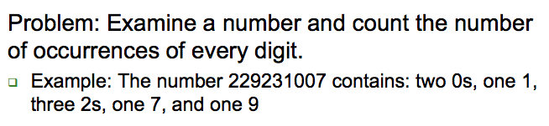
Digit Counter
Notes:
int num = 229231007;
int[] counts = new int[10];
while (num > 0) {
int digit = num % 10;
counts[digit]++;
num = num / 10;

Slide 26
Multi-dimensional Arrays
Let’s say there’s a class of 8 students with 10 quiz grades each
How can we declare variables to store all this data?

Slide 27
Multi-dimensional Arrays
Let’s say there’s a class of 8 students with 10 quiz grades each. How can we declare variables to store all this data?
An array per student
An array per quiz

Slide 28
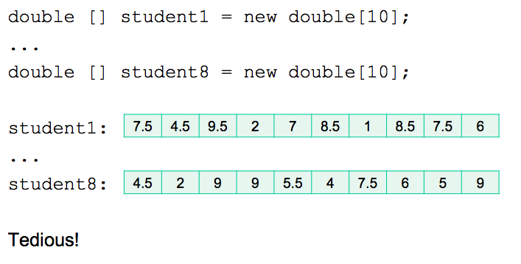
Multi-dimensional Arrays
An array per student

Slide 29
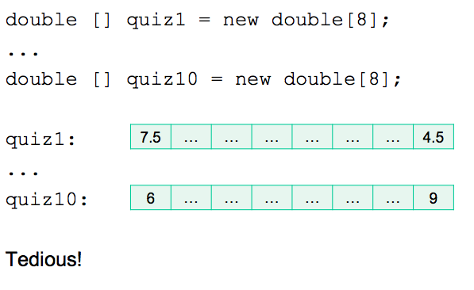
Multi-dimensional Arrays
An array per quiz

Slide 30
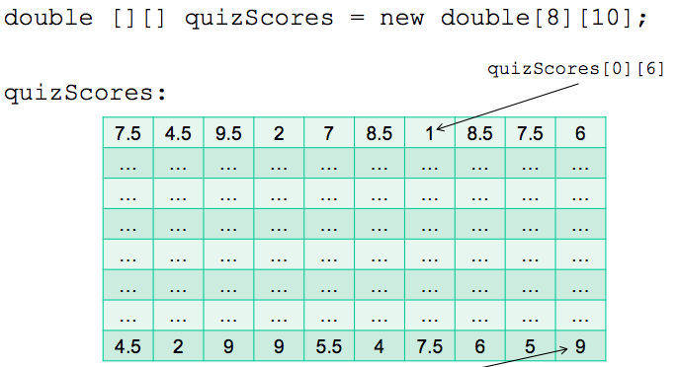
Multi-dimensional Arrays
2-dimensional arrays!
Notes:
Is just an array of arrays

Slide 31
Classroom Quiz

Slide 32
ArrayLists
Dynamically Changing Sized Arrays
Same basic functionality that comes with a standard array
Stores an ordered collection of values
allows access to the values via an index
Has an additional functionality:
Grows or shrinks dynamically by inserting and deleting elements at any specified location

Slide 33
How to create & use ArrayLists
ArrayList is defined in the Java API’s java.util package
So you must import: import java.util.ArrayList;
To initialize, see syntax:
ArrayList<element-type> NAME = new ArrayList<>();
So:
ArrayList<int> grades = new ArrayList<>();

Slide 34
How to create & use ArrayLists
ArrayList is defined in the Java API’s java.util package
So you must import: import java.util.ArrayList;
To initialize, see syntax:
ArrayList<element-type> NAME = new ArrayList<>();
So:
ArrayList<String> names = new ArrayList<String>();

Slide 35
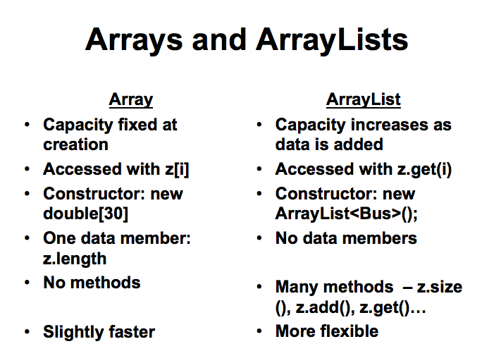
Notes:
ArrayList can only reference types, not primitives. Integer is a class, not a primitive.
When you declare ArrayList<Integer> list1 = new ArrayList<Integer>(), you're creating an ArrayList which will store the Integer type, not the int primitive.

Slide 36
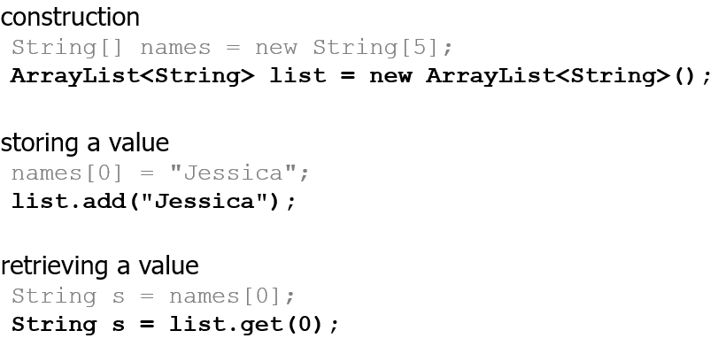
Arrays vs. ArrayLists

Slide 37
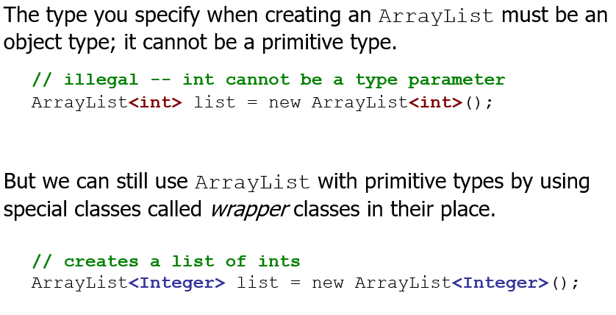
ArrayLists & Object Types

Slide 38
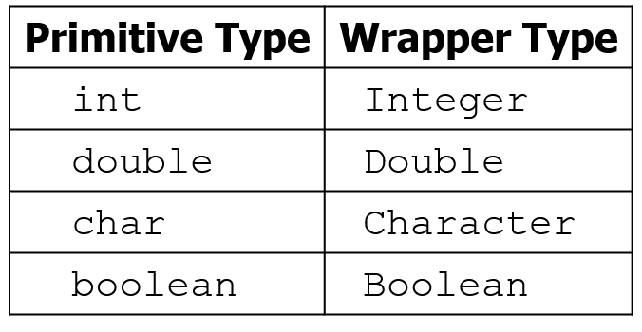
ArrayLists & Wrapper Classes

Slide 39
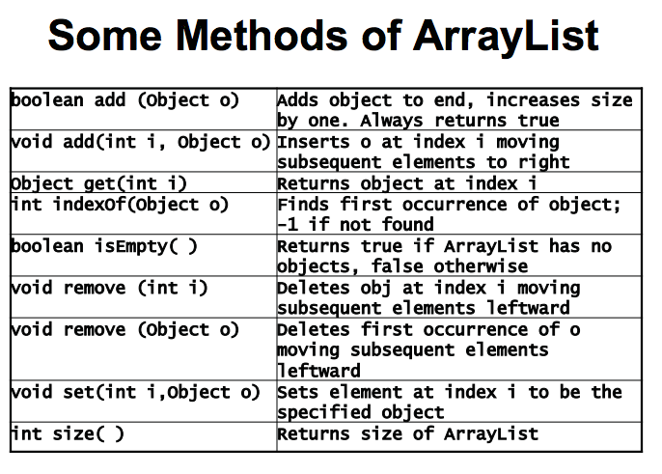

Slide 40
ArrayList Example
ArrayList<String> myArr = new ArrayList<String>(); myArr.add("Italian Riviera"); myArr.add("Jersey Shore"); myArr.add("Puerto Rico");
ArrayList can hold elements of different types
To check the size of an ArrayList
You do size() so: myArr.size();

Slide 41
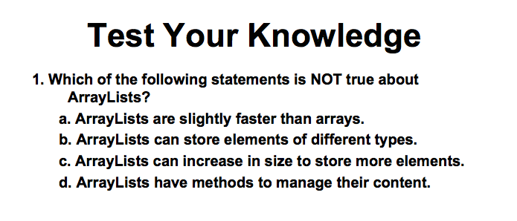

Slide 42
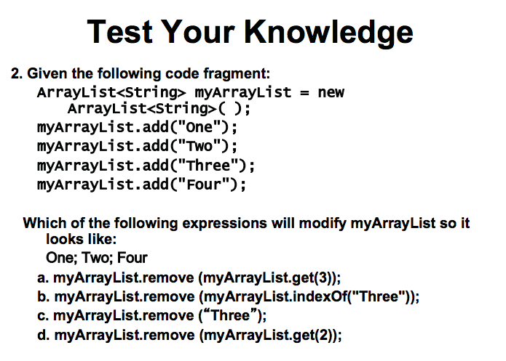

Slide 43
Other Exercises
Write a method reverse that reverses the order of the elements in an ArrayList of strings.
Write a method capitalizePlurals that accepts an ArrayList of strings and replaces every word ending with an "s" with its uppercased version.
Write a method removePlurals that accepts an ArrayList of strings and removes every word in the list ending with an "s", case-insensitively.

Slide 44
Exercise
Write a method addStars that accepts an array list of strings as a parameter and places a * after each element.
Example: if an array list named list initially stores:
[the, quick, brown, fox]
Then the call of addStars(list); makes it store:
[the, *, quick, *, brown, *, fox, *]
Write a method removeStars that accepts an array list of strings, assuming that every other element is a *, and removes the stars (undoing what was done by addStars above).

Slide 45
Exercise
Write a method intersect that accepts two sorted array lists of integers as parameters and returns a new list that contains only the elements that are found in both lists.
Example: if lists named list1 and list2 initially store:
[1, 4, 8, 9, 11, 15, 17, 28, 41, 59]
[4, 7, 11, 17, 19, 20, 23, 28, 37, 59, 81]
Then the call of intersect(list1, list2) returns the list:
[4, 11, 17, 28, 59]

Slide 46
Other Exercises
Write a method reverse that reverses the order of the elements in an ArrayList of strings.
Write a method capitalizePlurals that accepts an ArrayList of strings and replaces every word ending with an "s" with its uppercased version.
Write a method removePlurals that accepts an ArrayList of strings and removes every word in the list ending with an "s", case-insensitively.

Slide 47
Exceptions
The term exception is used to refer to the type of error that one might want to handle with a try...catch.
The term is used in preference to “error” because in some cases, an exception might not be considered to be an error at all.
You can sometimes think of an exception as just another way to organize a program.
When an exception occurs, we say that the exception is “thrown”.

Slide 48
Try… Catch
Integer.parseInt(str) throws an exception of type NumberFormatException when the value of str is illegal.
When an exception is thrown, it is possible to “catch” the exception and prevent it from crashing the program.
The exception-class-name could be NumberFormatException, IllegalArgumentException, or some other exception class.
try {
statements
}
catch ( exception-class-name variable-name) {
statements
}

Slide 49
Try… Catch
try {
double x;
x = Double.parseDouble(str);
System.out.println( "The number is " + x );
}
catch ( NumberFormatException e ) {
System.out.println( "Not a legal number." );
}

Slide 50
finally Block
The finally block always executes when the try block exits. This ensures that the finally block is executed even if an unexpected exception occurs.
finally is useful for more than just exception handling — it allows the programmer to avoid having cleanup code accidentally bypassed by a return, continue, or break.
Putting cleanup code in a finally block is always a good practice, even when no exceptions are anticipated.

Slide 51
Try… Catch … Finally
try {
reader = new FileReader("someFile");
int i=0;
while(i != -1){
i = reader.read();
System.out.println((char) i );
}
}
catch (IOException e) {
//do something clever with the exception
}
finally {
System.out.println("--- File End ---");
}

Slide 52
Next Time
Psuedo Coding & Program Design
Objects & Classes (constructors, object initialization)
Inheritance & Polymorphism
This and super
GUI Programming
APIs, Packages

Slide 53
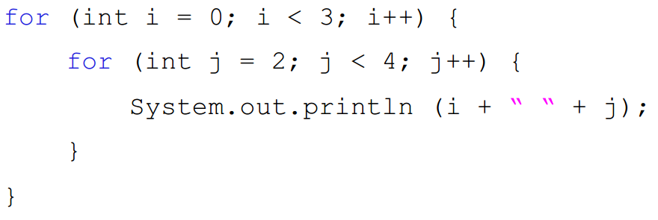
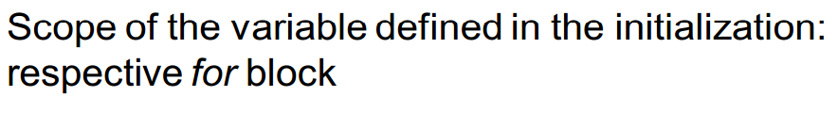
Nesting
Use indenting to emphasize nesting
Indenting helps distinguish between loops (outer, inner)

Slide 54
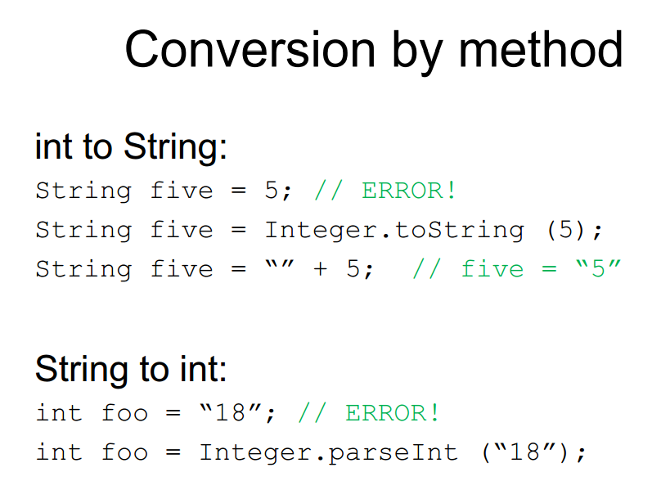

Slide 55
Array Exercise
Write a program that reads in 10 temperature values (as doubles) for 10 days of weather, computes the average temperature, and displays the number of days that were hotter than the average.
Notes:
Hint: use two accumulate loops, one to compute the sum of the array of temperatures, and one to compute the number of days above average.
import java.util.Scanner; public class DaysAboveAverage { public final int NUM_DAYS = 10; public static void main(String [] args) { Scanner keyboard = new Scanner(System.in); double [] store = new double[NUM_DAYS]; // sum algorithm double sum = 0; for(int i=0; iavg) { count++; } } System.out.println("avg temp = " + avg + " and " + count + " days above avg"); }

Slide 56
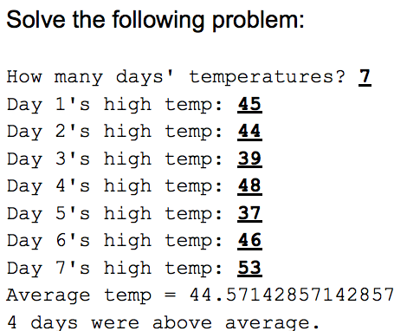

Temperature Days

Slide 57
More Exercises?
Read in 10 ints from the keyboard, and store them in an array. Find the position (or index) of the maximum and minimum values in the array, and swap them (move the biggest element to the position of the smallest, and move the smallest element to the position of the biggest).
Notes:
Write a function that concatenates two lists.
Write a function that tests whether a string is a palindrome.
http://adriann.github.io/programming_problems.html
ftp://ftp.fixme.ch/free_for_all/Ebook/IT%20eBooks/Software%20Engineering/Best%20Practices%20%28Language%20Neutral%29/Personal%20%28Career%20Advice%29/Programming%20Interviews%20Exposed.PDF
Reverse elements in array
http://chortle.ccsu.edu/Java5/Notes/chap47/progExercises47.html
Exercise 3 — Three Arrays
Examine the following program:
class Exercise3 { public static void main ( String[] args ) { int[] valA = { 13, -22, 82, 17}; int[] valB = {-12, 24, -79, -13}; int[] sum = { 0, 0, 0, 0}; // Add values from corresponding cells of valA and valB // and put the result in the corresponding cell of sum. System.out.println( "sum: " + sum[0] + " " + sum[1] + " " + sum[2] + " " + sum[3] ); } }

Slide 58
Reading input from console
import java.util.Scanner;
public static void main(String[] args) {
Scanner scanner = new Scanner(System.in);
System.out.println(“Name:”);
String input = scanner.next();
System.out.println(“Hello ”+ input);
scanner.close();
}

Slide 59
Scanner Class
Scanner scan = new Scanner(System.in);
int num = scan.nextInt();
double d = scan.nextDouble();
String s = scan.next();
String s = scan.nextLine();
boolean b = scan.hasNext() (or scan.hasNextInt();)
scan.close();

Slide 60
